Slide 1
Newton High School Title I Parent Night
Notes:
SJDB SV SVAREFJQERBFQI

Slide 2
Agenda …
AGENDA
Introductions
College and Career Specialists
&
College Advisors
What We Do & How We Help
Early Planning
College Planning
Career Planning
District Platforms
SCOIR
Virtual Job Shadow (Pathful)
YouScience
Upcoming Events
Apply to College Month
Apprenticeship Panel
Questions & Answers
Social Media

Slide 3
Newton County
College and Career Specialist
Stephen Woodall
Kayla Walker
Early Planning
College Planning
Stephen Woodall
Jordan Troutman
Early Planning
Career Planning
Notes:
GHLKJFNAE,JRMBEAJRFBERAF

Slide 4
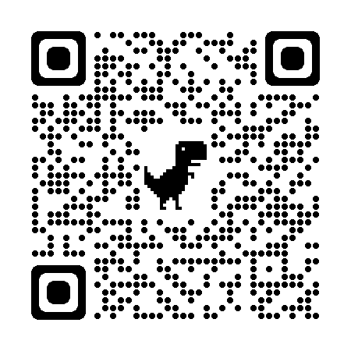
Connect With Us
@CCR_NEWTON
@CCR_NEWTON
Text CCRNewton to 81010
www.newtonccr.com

Slide 5
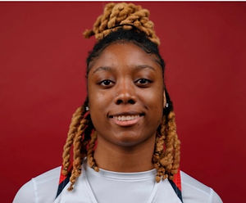
V
NHS College Advisor
Jurnee Smith
Newton High School
Smith.jurnee@newton.k12.ga.us
Remind: @newton24

Slide 6
Early Planning
Early Planning Support
Pre-College Programs
Using the SCOIR platform for College and Career Exploration
Understanding how the PSAT scores opens College and Scholarship opportunities
Using YouScience Assessment results to identify best-fit colleges and careers
Using Student Activities to build resumes and soft skills
Providing Summer Experiences to assist with College and Planning
"BePro BeProud" Career Expo
Oxford College Summer Experience
Explore Engineering at UGA
GSU C.O.R.E. (Center for Opportunity & Engagement)
REACH Georgia Scholarship Program

Slide 7
Career Exploration & Planning
Exploration
Planning
Industry Tours
Local Employers
Various Career Fields
Entry Level Positions
Training Institutes
AECA
MTI
College Tours and Career Fairs
Pathful Explore
(Virtual Job Shadowing)
Career Aptitude Assessments (YouScience)
Resume prep and Mock Interviews
Employability Skills Workshops
Goal Setting

Slide 8
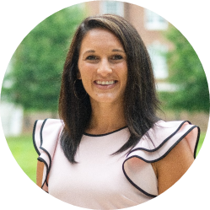
College Planning 11th & 12th
Exploration
Planning
Finding your best bit
Type of college
Student experience
Specialized programs
Academic program of study
College tours and campus visits
College fairs
Admission decision type
Regular decision, early decision, early action
College application process
College decision
Admission requirements & deadlines
Financial aid
FAFSA, scholarships, grants and loans
Standardized test prep (SAT / ACT)
Grade level checklists
Tools and resource

Slide 9
Types of College Pathways
Pathways after high school
2 Year College
Technical College
4 Year College
Apprenticeship
Specialized College
Military

Slide 10
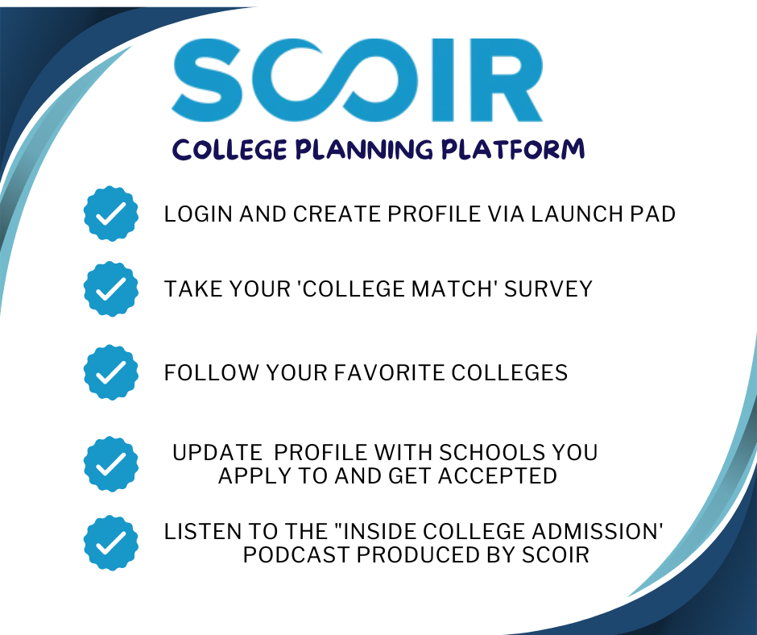

Slide 14
How to Get Federal Student Aid
Be a U.S. citizen or eligible non-citizen
Be a high school graduate or GED recipient
Be enrolled in an eligible degree/certificate program
Have a valid Social Security number
Maintain Satisfactory Academic Progress
Notes:
There are certain eligibility requirements in order to receive federal aid. These requirements are for the student not the parents.

Slide 15
Federal Financial Aid Programs Grants
Pell Grant
Undergraduate student with financial need
Maximum amount for 2023-24 is $7,395
Federal Supplemental Educational Opportunity Grant (FSEOG)
Undergraduate student with exceptional financial need
Pell Grant recipients receive priority
Up to $4,000
Notes:
The federal government has financial aid programs that include grants and work-study awards that do not need to be repaid, as well as various loans that require repayment. For more information, visit studentaid.gov

Slide 16
Federal Financial Aid Programs Grants
Federal Work Study Program
Full-time or part-time undergraduate or graduate student
Earn at least minimum wage
On-campus positions
Campus tour guide
Library
Sporting events
Office assistant

Slide 17
Federal Financial Aid Programs Direct Subsidized Loans
Direct Subsidized Loan
Available to undergraduate students with financial need
Interest is paid by the government while enrolled (at least half time)
Amount determined by institution and based on COA, financial need, other aid and loan limits
Current interest rate 5.50% (undergraduate)

Slide 18
Federal Financial Aid Programs Direct Unsubsidized Loans
Direct Unsubsidized Loan
Available to undergraduate/graduate students
Institution determines the amount based on COA, other financial aid awarded, and loan limits
Student responsible for paying the interest
Can choose to defer interest while enrolled at least half time, but interest will be added to the principal amount of loan
Current interest rate 5.50% (undergraduate)
Current interest rate 7.05% (graduate/professional)

Slide 21
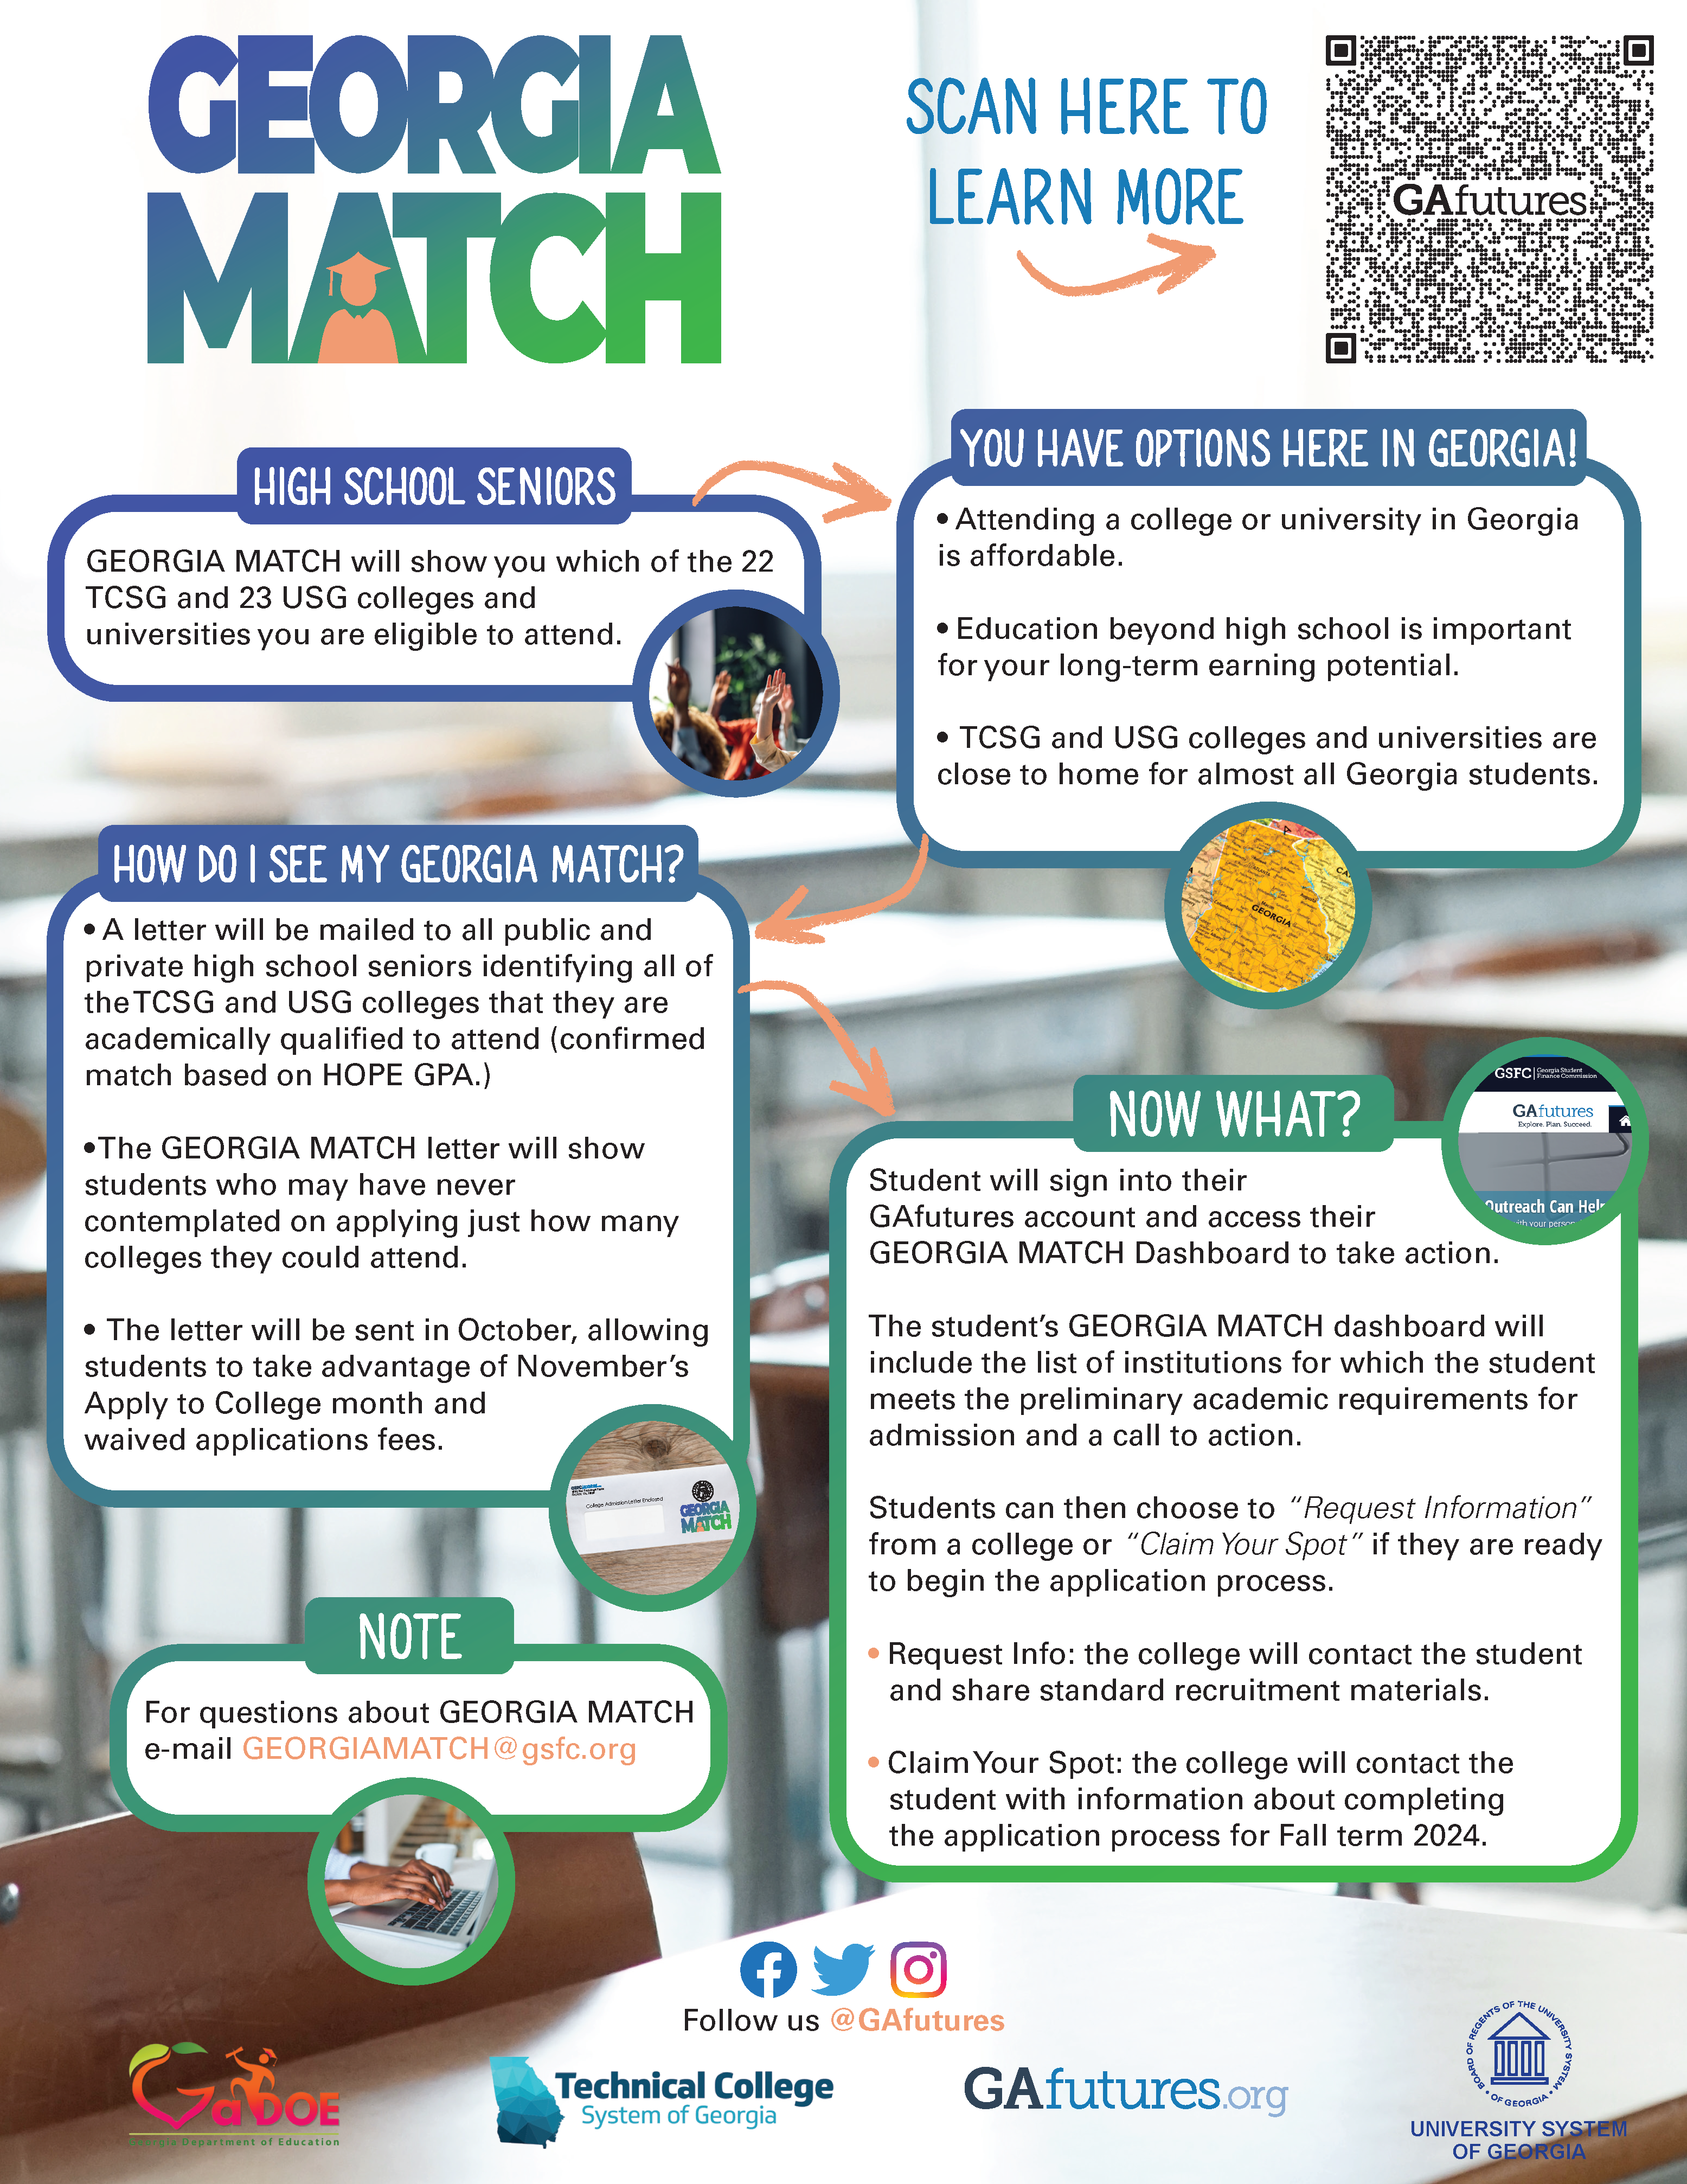

Slide 22
Helping Outstanding Pupils Educationally Program
HOPE Scholarship
Zell Miller Scholarship
HOPE
Grant
HOPE Career Grant
Zell Miller Grant
Notes:
Think of the HOPE Program as a family and the Georgia Lottery as the parent. The HOPE Program provides money to assist students with their educational costs.
click

Slide 24
Connect With Us
@CCR_NEWTON
@CCR_NEWTON
Text CCRNewton to 81010
www.newtonccr.com

